Slide 1

AirFly Insights
Data Visualization and Analysis of Airline Operations
Analyzing large-scale flight data to uncover trends, delays, and operational patterns for actionable insights.
Mentor: Rahul Yadav
Domain - Data Visualization
Submitted By – Sankeerthan Akula

Slide 2
Table of Contents
Our analysis follows a systematic process, from data acquisition to the final delivery of strategic insights for airline operations.
Project Overview
Delay Cause Analysis
Define objectives and scope.
Identifying root causes of delays.
Dataset & Tech Stack
Route & Airport Analysis
Source and tools selection.
Performance evaluation.
Preprocessing & EDA
Seasonal Insights
Cleaning data and initial exploration.
Identifying temporal patterns.
Feature Engineering
Cancellation Insights
Creating relevant variables.
Understanding frequency and reasons.
Univariate & Bivariate Analysis
Dashboard
Detailed statistical comparisons.
Visual representation of airfly insights using PowerBI.

Slide 3
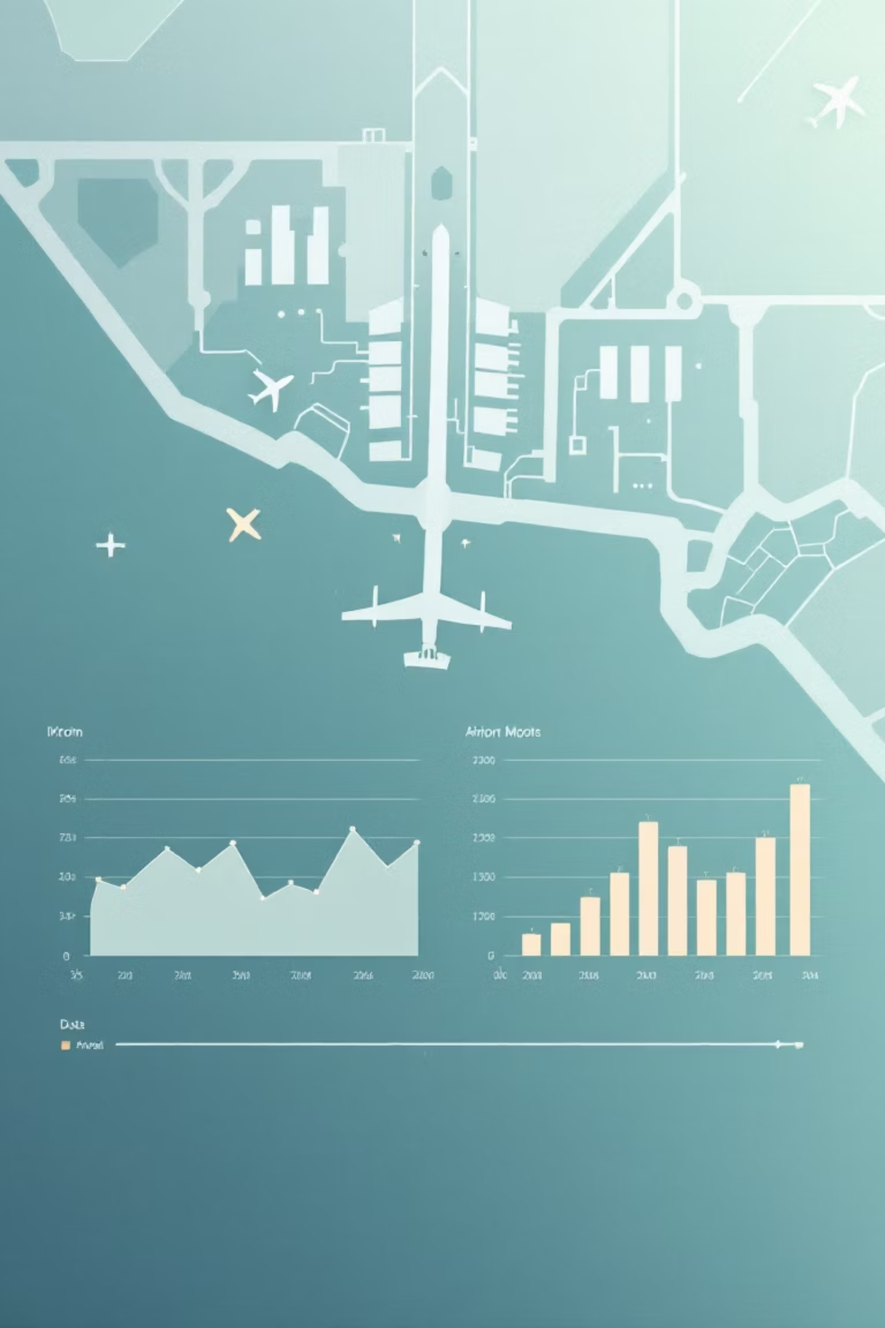
Project Overview:
Objective:To analyze large-scale airline flight data to uncover operational trends, delay patterns, and cancellation reasons using data visualization techniques.
Goals:
•Understand and preprocess aviation datasets
•Explore flight, delay, and cancellation trends
•Visualize metrics using charts, heatmaps, and maps
•Deliver insights for airlines and airports

Slide 4
Dataset:
Flight Delay and Cancellation Dataset (2019-2023)
A dataset containing detailed records of flight delays and cancellations from 2019 to 2023, including flight schedules, delay durations, and reasons for disruptions.
Flight Delay and Cancellation Dataset (2019-2023)
Reasons:
• Includes detailed flight, delay, and cancellation records across multiple airlines for accurate delay prediction.
• Contains 8500+ entries, providing ample data for reliable machine learning model training.
• Covers flight schedules, durations, and disruption reasons, enabling comprehensive operational analysis.
• Mimics real-world aviation scenarios, offering valuable insights for improving airline efficiency and passenger experience.

Slide 5




Technology Stack:
A robust set of technologies was selected to efficiently process, analyze, and visualize the large volume of flight data.
Python
Pandas & NumPy
Core language for data manipulation, cleaning, and model development.
Essential libraries for high-performance data structuring and numerical operations.
Visualization Libraries
Power BI & Jupyter
Matplotlib, Seaborn, or Plotly for creating static and interactive data plots.
Power BI for interactive dashboards and Jupyter notebooks for iterative analysis and documentation.

Slide 6
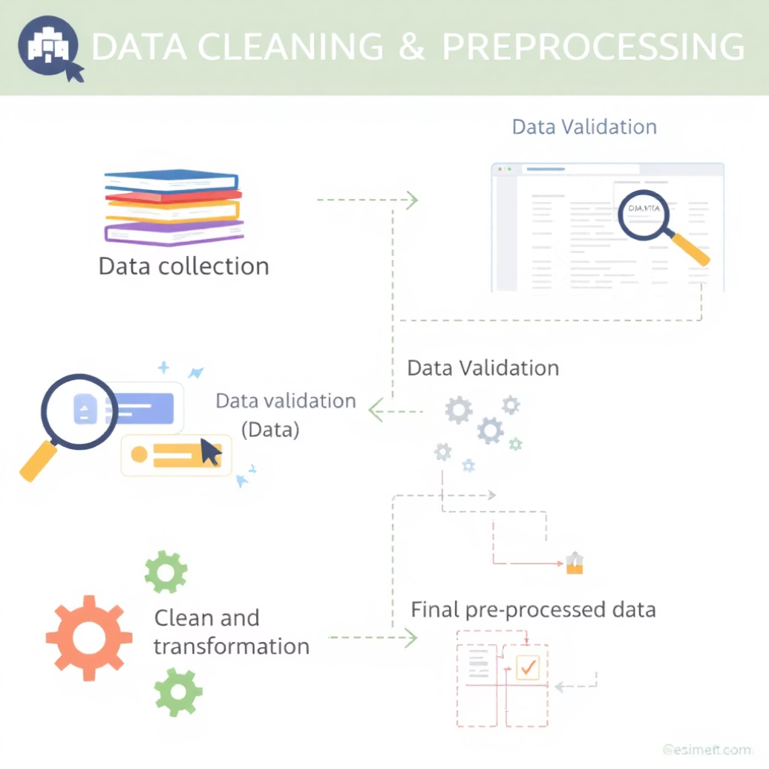




Data Preprocessing & Cleaning Strategy
Ensuring data quality is the critical first step. This involved several key actions to prepare the raw data for robust analysis.
Data Loading & Date Conversion
Loaded dataset using pd.read_csv() and converted FL_DATE column to datetime format
Feature Extraction
Extracted new temporal features: Year, Month, Day, DayOfWeek from date columns
Time Format Processing
Converted scheduled and actual times (HHMM format) into readable hours and minutes
Delay Aggregation
Created TotalDelay column as sum of all delay types (CARRIER + WEATHER + NAS + SECURITY + LATE_AIRCRAFT) and dropped redundant columns

Slide 7
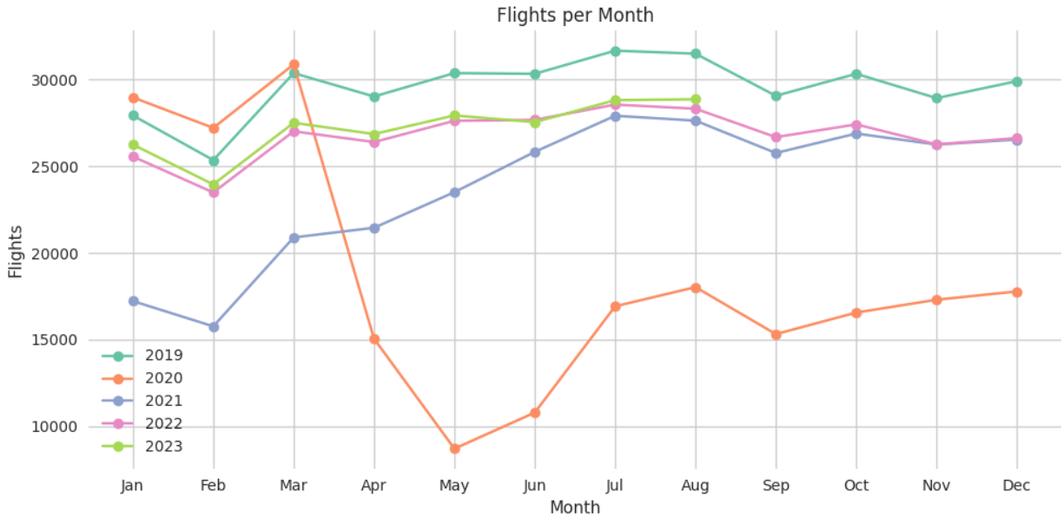
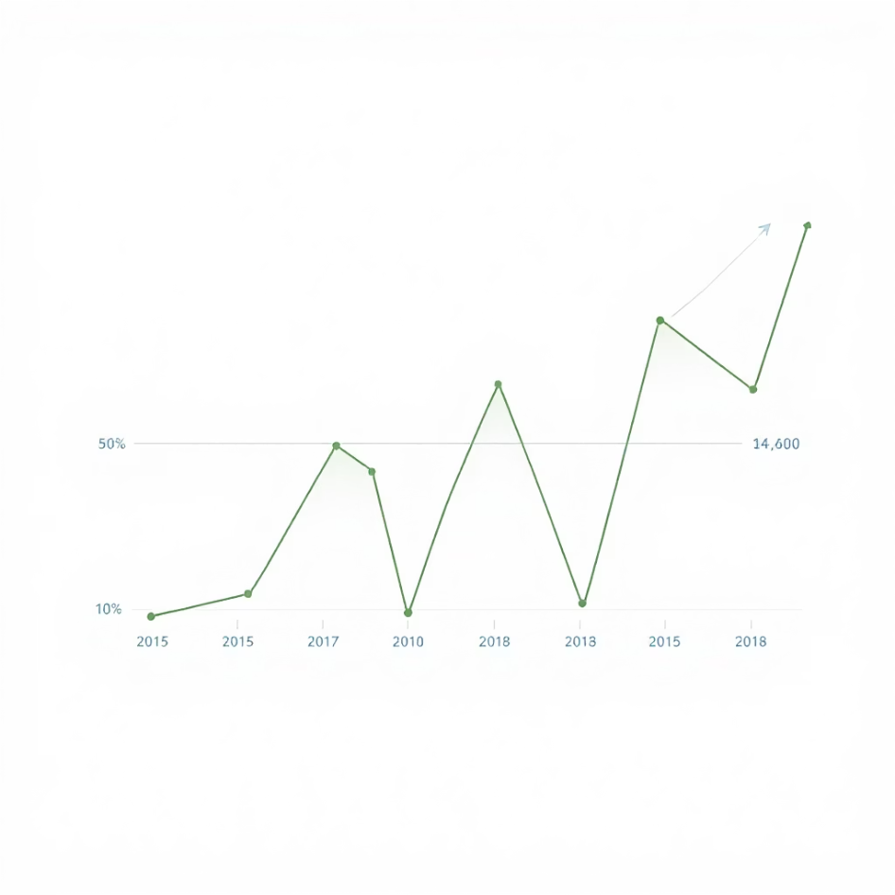
Exploratory Data Analysis (EDA)
Initial analysis provided foundational understanding of the data distribution, volume, and basic operational characteristics.
Data Quality Assessment
Displayed dataset info and data types using .info()
Checked for missing values and duplicates in the dataset
Computed summary statistics using describe() function
Initial Visualizations
Distribution of departure and arrival delays
Count of flights per carrier and per month
Weekly flight frequency and average delay trends
Visualizing the initial data distributions helps confirm expectations and highlight areas requiring deeper feature engineering.

Slide 8
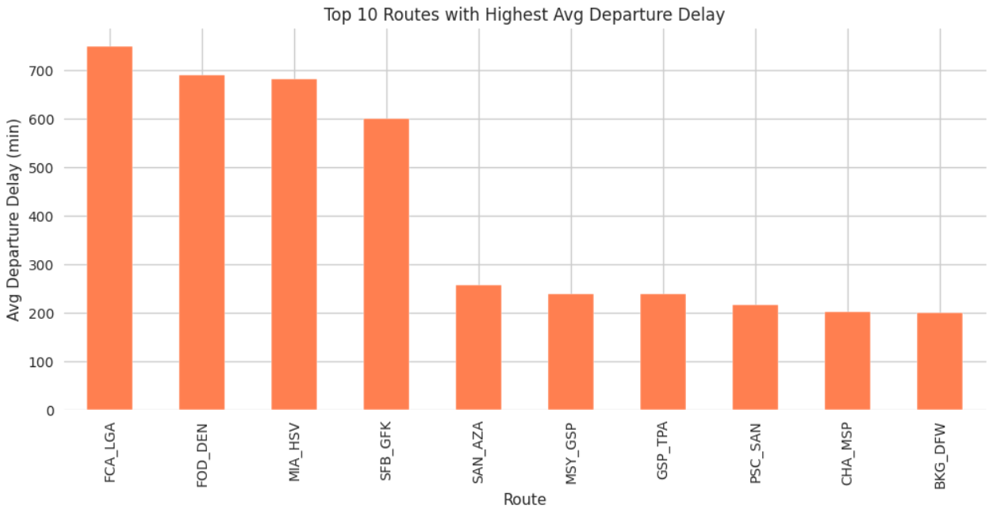
Feature Engineering:
We created new, meaningful features from the raw data to capture complex operational factors affecting flight performance.
Temporal Features
Extraction of Hour of Day, Day of Week, and Month to model time-dependent patterns in delays.
Load and Capacity Metrics
Calculating rolling averages of flight frequency and delay severity for each carrier and airport (e.g., Average Delay Last 7 Days).
Route and Segment Variables
Creating a unique Route Identifier (Origin-Destination pair) to analyze route-specific performance bottlenecks.

Slide 9
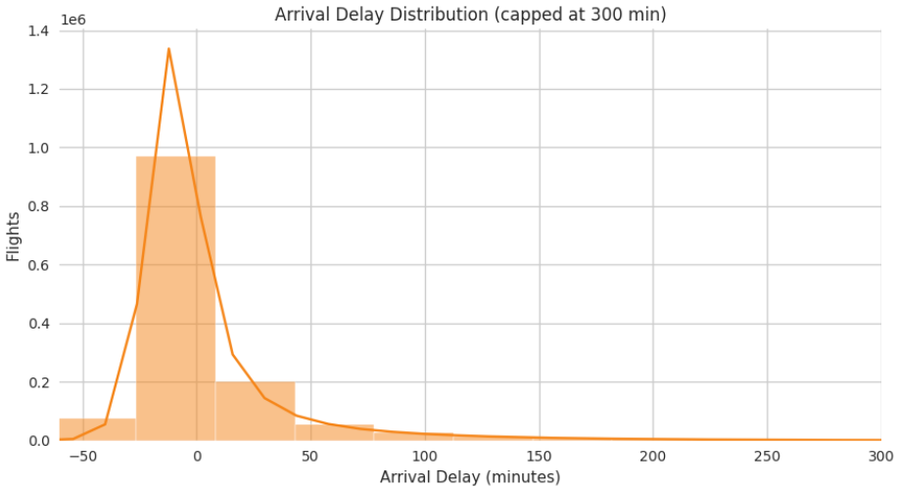
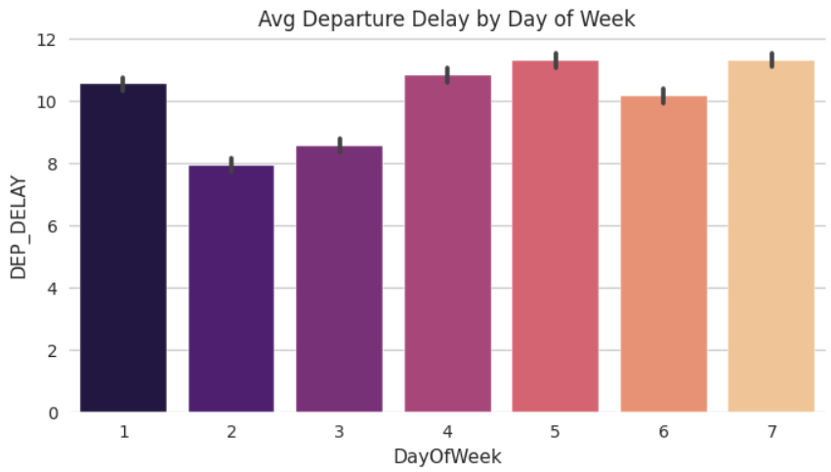
Univariate & Bivariate Analysis
Detailed statistical examination of individual variables and their relationships to uncover patterns in flight operations.
Univariate Analysis:
Bivariate Analysis:
Flight delay distribution shows heavy right skew with most flights having minimal delays
Strong correlation between flight distance and average delay duration
Carrier performance varies significantly with some airlines showing consistently higher delay rates
Day of week significantly impacts on-time performance with Fridays showing highest delays
Airport size correlates with delay frequency but not necessarily delay duration
Airport traffic volume analysis reveals clear hub-and-spoke patterns
Weather conditions show predictable relationships with cancellation rates
Temporal patterns show peak delay times during morning and evening rush hours
Flight Delay Distribution
Average Delay by Day of Week
This chart illustrates the average flight delay duration across different days of the week, clearly showing that Fridays experience the highest average delays, highlighting a significant temporal pattern.
The bar chart above illustrates that the majority of flights experience minimal delays (0-50 minutes), with a steep decline in frequency as delay durations increase, indicating a right skewed distribution.

Slide 10
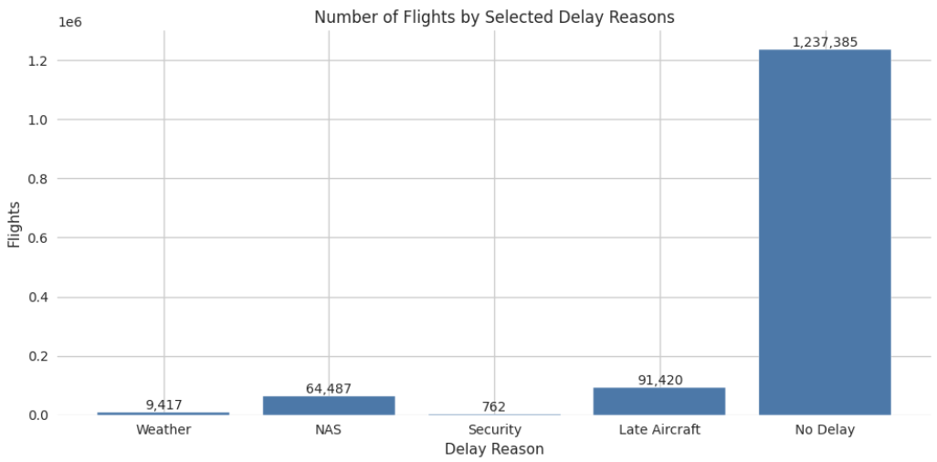
Delay Cause Analysis
Understanding the primary drivers of flight disruptions through comprehensive data analysis.
Carrier Delays
National Aviation System (NAS) Delays
Carrier delays (internal airline issues) are the most significant factor, accounting for the largest portion of total delay minutes
National Aviation System (NAS) delays follow as the second major cause, related to air traffic control and airport capacity constraints
Weather-Related Delays
Security-Related Delays
Weather-related delays represent a substantial but seasonal factor in flight disruptions
Security-related delays are consistently the smallest cause but often result in the longest individual delay durations
Late Aircraft Delays
Late aircraft delays create cascading effects throughout the day's flight schedule

Slide 11
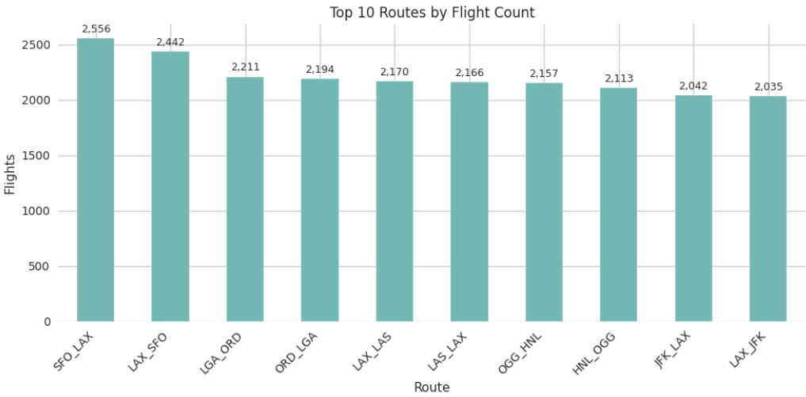
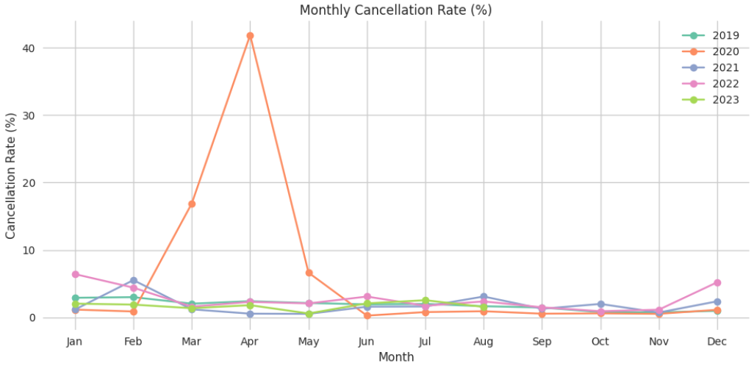
Route & Airport Analysis
Evaluating performance patterns across different routes and airports to identify operational bottlenecks and efficiency opportunities.
High-Traffic Routes
Airport Performance
Major hub-to-hub routes (e.g., LAX-JFK, ORD-ATL) show higher delay frequencies due to congestion
Large hub airports (ATL, ORD, DFW) handle high volumes but maintain relatively efficient operations
Transcontinental routes experience longer average delays compared to regional flights
Popular vacation destinations show seasonal delay spikes during peak travel periods
Weather-sensitive airports (Northeast, Great Lakes region) show higher cancellation rates
Smaller regional airports often have better on-time performance but limited recovery options
Cancellation Rate (%)
Route Efficiency Metrics
Short-haul routes (under 500 miles) have lowest delay variability
International gateway airports show distinct delay patterns based on customs and immigration processing

Slide 12
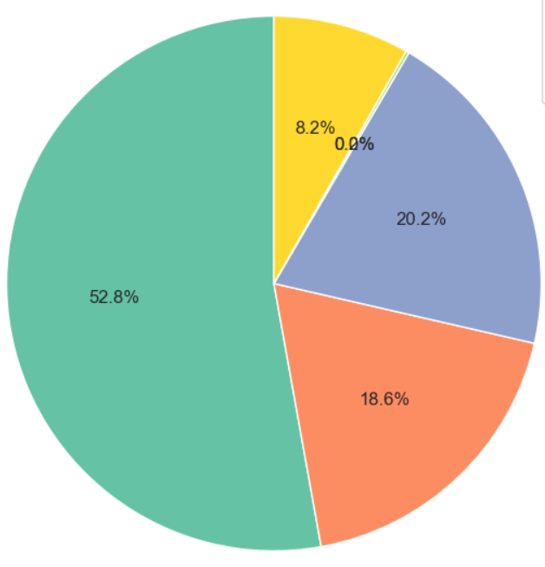
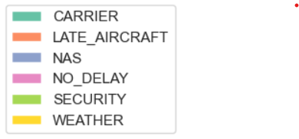
Flight Cancellation Insights
The majority of flight cancellations are caused by Carrier, making it the biggest disruption factor. Here’s the breakdown:
Cancellation Reasons:
Carrier: (52.8%) flights
NAS: (20.3%) flights
Late Aircraft: (18.6%) flights
Weather: (8.2%) flights
Security: (0.0%) flights
No Delay: (0.0%) flights

Slide 13
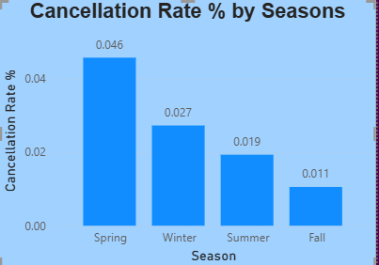
Seasonal Insights
Cancellations peak in Spring and Winter due to weather and operational challenges, while Summer and Fall show the lowest rates, indicating more stable travel conditions.
Spring has the highest cancellations – weather volatility.
Winter is second – cold conditions & delays.
Summer is lower – stable weather improves operations.
Fall has the least cancellations – best time for consistent travel.

Slide 14

Thank You!

